Slide 1
Faith in God Session 05
Course : CB Pancasila
Effective Period : 2017

Slide 2
Student will be able to explain and apply their faith to God Almighty
Learning Objectives

Slide 3
Trust in God
Is God Plural? What is the role of God in the life?
What are the consequences of our picture of God?

Slide 4
Some Practices of The Principle of Believe in God
Believe in God as their own religions
The mutual respects and cooperation of inter religions
The mutual respects in doing the rituals of their own religions
The ‘not imposing’ practices of their own religions to others

Slide 5
Concept of God in Religions
How do humans in describe God?
? ? ? ? ? ?

Slide 6
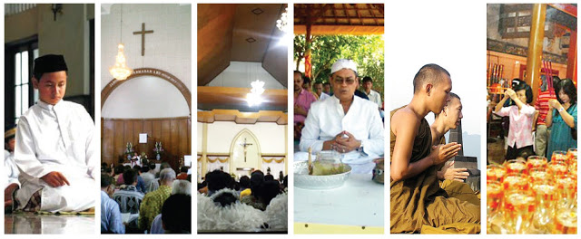
Vertical Human Relation with God
http://blogcadiak.blogspot.co.id/2016/08/beriman-dan-bertakwa-kepada-tuhan-yang.html
The meaning of worship to God:
Faith celebration
Bring all life activities to God
Get inspiration for life

Slide 7

Discussion
Could you descript the application of belief in the One God in Indonesia?

Slide 8
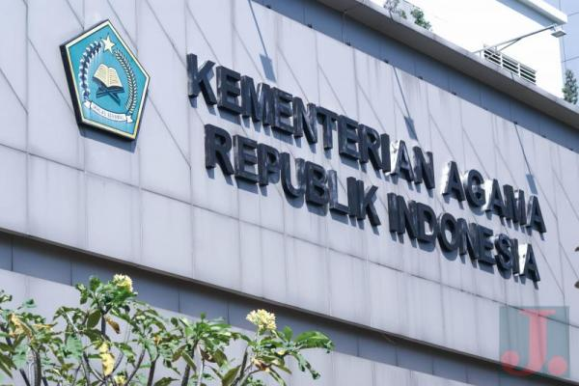
Case study
Read the article based on the following link ….
And give your opinion
http://www.jurnas.com/artikel/15574/RUU-Perlindungan-Umat-Beragama-Segera-Masuk-BPHN/

Slide 9
Question and Answer
?

Slide 10
References
Tim Penulis CB: Pancasila (2014). Diktat Kuliah Character Building: Pancasila. Binus University: CBDC, 000
Gambar lambang sila 1: http://blognyavarra.blogspot.co.id/2010/08/pkn-maknaarti-lambang-garuda-pancasila.html
Gambar ibadah: http://blogcadiak.blogspot.co.id/2016/08/beriman-dan-bertakwa-kepada-tuhan-yang.html
Gambar Departemen Agama & Case Study:
http://www.jurnas.com/artikel/15574/RUU-Perlindungan-Umat-Beragama-Segera-Masuk-BPHN/

